Slide 1
CS 405/605 Data Science
Dr. Qianqian Tong

Slide 2
Course Schedule
Week 13: April 3 topic: Random Forest
April 5 topic: Validation
Project stage IV and V released, and the ddl will be April 28.
Week 14: April 10 topic: PCA
April 12 topic: Clustering-Kmeans
Week 15: April 17 topic: Visualization
April 19 topic: Visualization
HW3 will be released, and the ddl will be April 28.
Week 16: April 24 Project Presentation (4 groups, each will have 15-20 min)
April 26 Project Presentation (4 groups, each will have 15-20 min)
All reports and homework must be submitted by April 28, and graded by the final week.

Slide 3
Validation
Model Evaluation
Metrics for Performance Evaluation
How to evaluate the performance of a model?
Methods for Performance Evaluation
How to obtain reliable estimates?
Methods for Model Comparison
How to compare the relative performance among competing models?

Slide 4
Validation
Model Evaluation
Metrics for Performance Evaluation
How to evaluate the performance of a model?
Methods for Performance Evaluation
How to obtain reliable estimates?
Methods for Model Comparison
How to compare the relative performance among competing models?

Slide 5
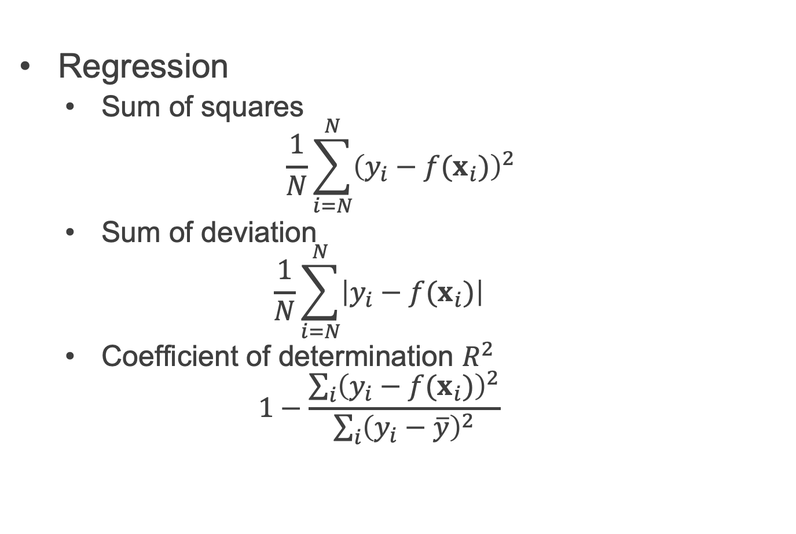
Validation
Metrics for Performance Evaluation
Regression
Sum of squares
$$\frac{1}{N}\sum_{i=N}^{N}{{\left(y_{i}−f(x_{i})\right)}^{2}}$$
Sum of deviation
$$\frac{1}{N}\sum_{i=N}^{N}{\left|y_{i}−f(x_{i})\right|}$$
Coefficient of determination $R^{2}$
$$1−\frac{\sum_{i}{{\left(y_{i}−f(x_{i})\right)}^{2}}}{\sum_{i}{{\left(y_{i}−\overline{y}\right)}^{2}}}$$

Slide 6
Validation
Metrics for Performance Evaluation
Focus on the predictive capability of a model
Rather than how fast it takes to classify or build models, scalability, etc.
Confusion Matrix:
 | PREDICTED CLASS
ACTUAL CLASS |  | Class=Yes | Class=No
 | Class=Yes | a | b
 | Class=No | c | d
a: TP (true positive)
b: FN (false negative)
c: FP (false positive)
d: TN (true negative)

Slide 7
Validation
Metrics for Performance Evaluation
Most widely-used metric:
 | PREDICTED CLASS
ACTUAL CLASS |  | Class=Yes | Class=No
 | Class=Yes | a (TP) | b (FN)
 | Class=No | c (FP) | d (TN)

Slide 8
Validation
Metrics for Performance Evaluation
 | PREDICTED CLASS
ACTUAL CLASS |  | Class=Yes | Class=No
 | Class=Yes | a (TP) | b (FN)
 | Class=No | c (FP) | d (TN)
Precision is biased towards C(Yes|Yes) & C(Yes|No)
Recall is biased towards C(Yes|Yes) & C(No|Yes)

Slide 9
Validation
Metrics for Performance Evaluation
 | PREDICTED CLASS
ACTUAL CLASS |  | Class=Yes | Class=No
 | Class=Yes | a (TP) | b (FN)
 | Class=No | c (FP) | d (TN)
F-measure is biased towards all except C(No|No)

Slide 10
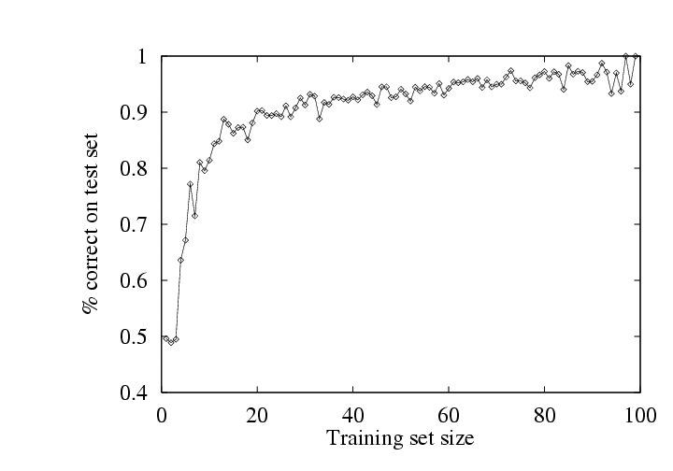
Validation
Assessing Performance
problem
- simulate 100 data sets of different sizes
- train on this data, and assess performance on an independent test set
- learning curve = plotting accuracy as a function of training set size
- typical “diminishing returns” effect (some nice theory to explain this)

Slide 11
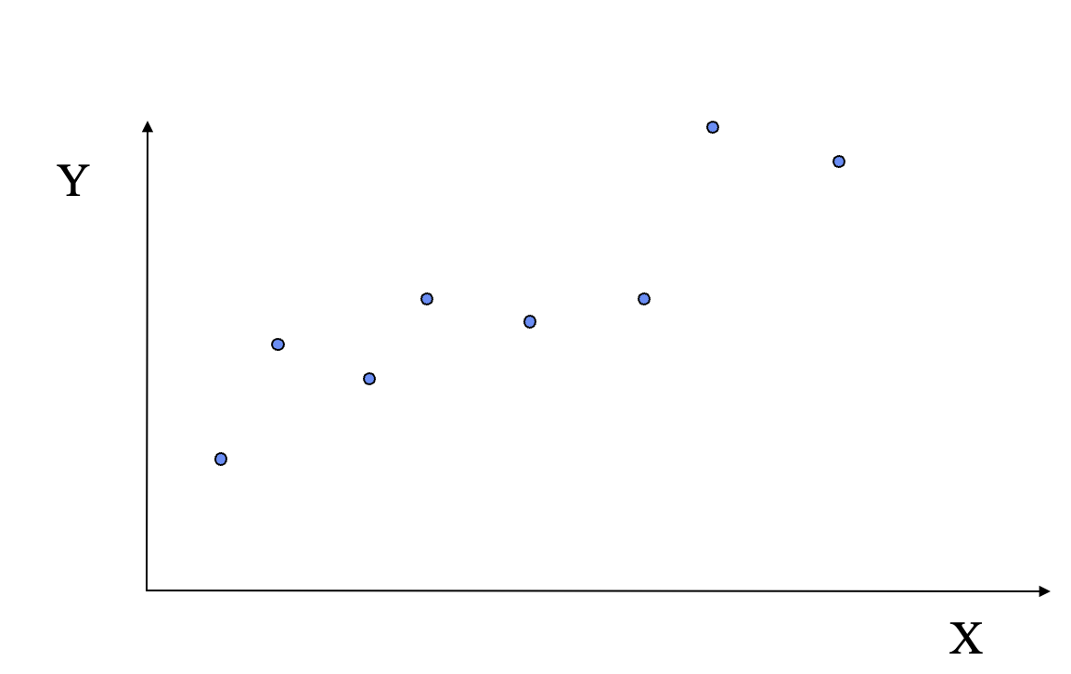
Validation
Assessing Performance
Overfitting and Underfitting

Slide 12
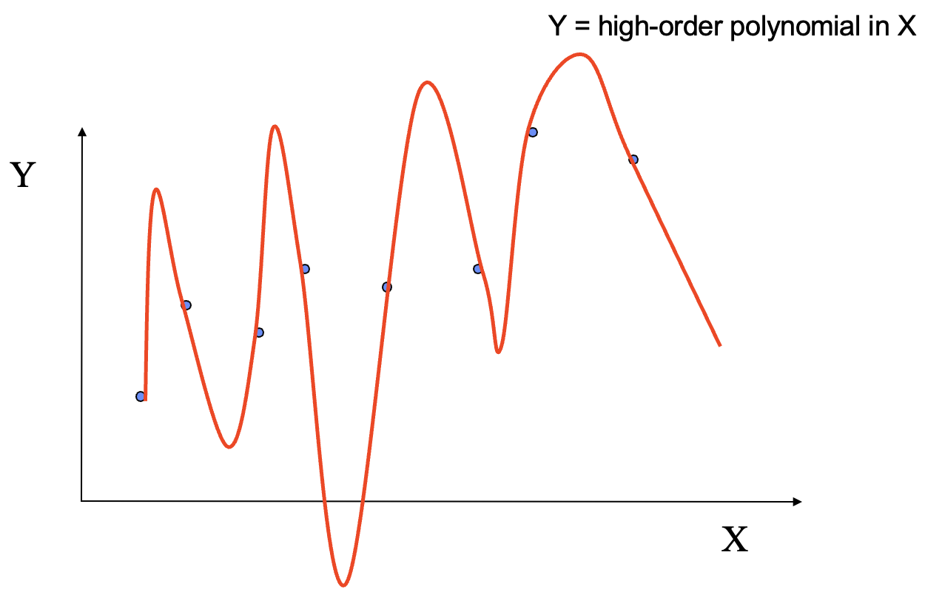
Validation
Assessing Performance
Overfitting and Underfitting
A Complex Model

Slide 13
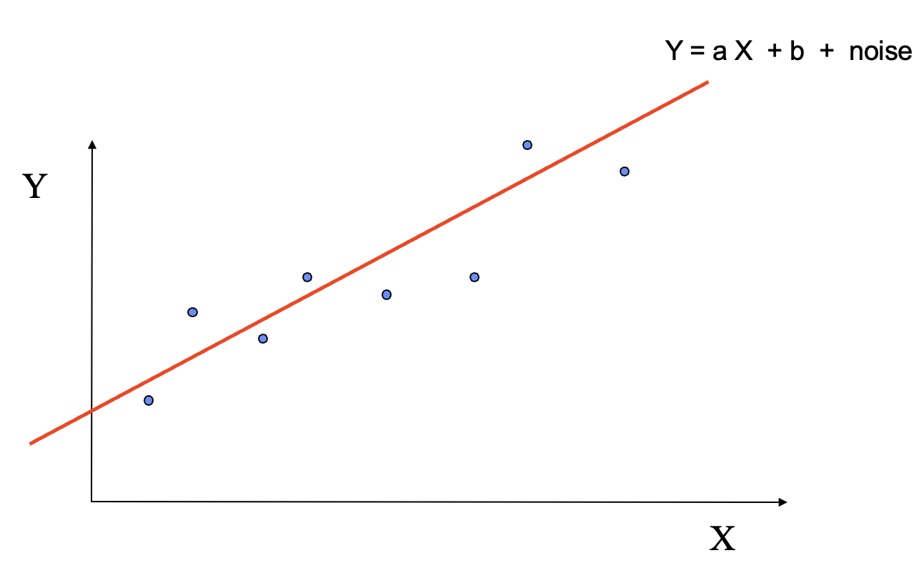
Validation
Assessing Performance
Overfitting and Underfitting
A Simple Model

Slide 14
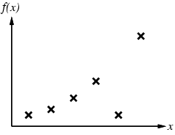
Validation
Assessing Performance
Overfitting and Underfitting
Another example

Slide 15
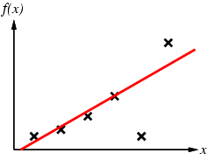
Validation
Assessing Performance
Overfitting and Underfitting
Simple linear model

Slide 16
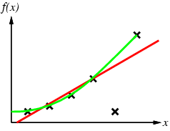
Validation
Assessing Performance
Overfitting and Underfitting
Simple linear model
VS
High order model

Slide 17
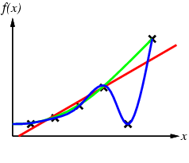
Validation
Assessing Performance
Overfitting and Underfitting
Simple linear model
VS
High order model

Slide 18
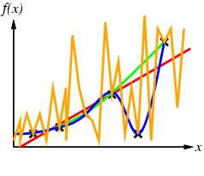
Validation
Assessing Performance
Overfitting and Underfitting
Simple linear model
VS
High order model

Slide 19
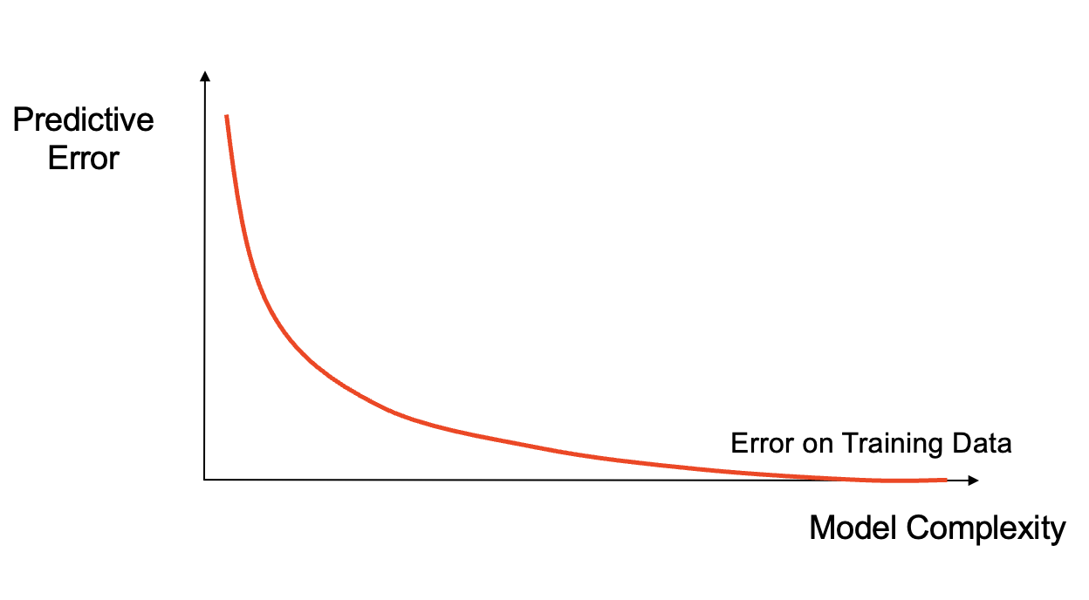
Validation
Assessing Performance
Overfitting and Underfitting
How Overfitting
affects Prediction

Slide 20
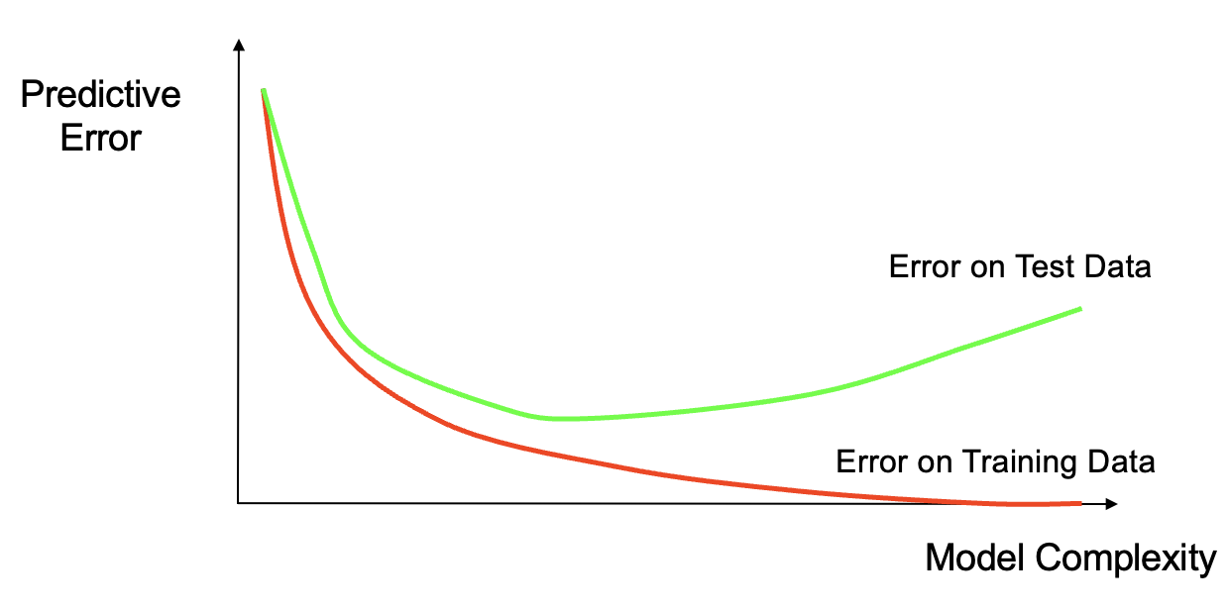
Validation
Assessing Performance
Overfitting and Underfitting
How Overfitting
affects Prediction

Slide 21
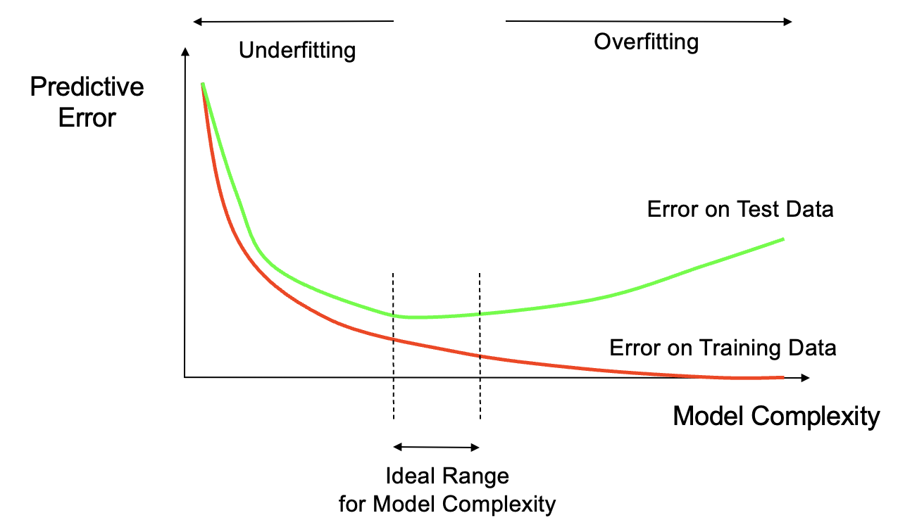
Validation
Assessing Performance
Overfitting and Underfitting
How Overfitting
affects Prediction

Slide 22
Validation
Model Evaluation
Metrics for Performance Evaluation
How to evaluate the performance of a model?
Methods for Performance Evaluation
How to obtain reliable estimates?
Methods for Model Comparison
How to compare the relative performance among competing models?

Slide 23
Validation
Methods for Performance Evaluation
Holdout
Reserve 2/3 for training and 1/3 for testing
Random subsampling
Repeated holdout
Cross validation
Partition data into k disjoint subsets
k-fold: train on k-1 partitions, test on the remaining one
Leave-one-out: k=n
Stratified sampling
oversampling vs undersampling
Bootstrap
Sampling with replacement

Slide 24
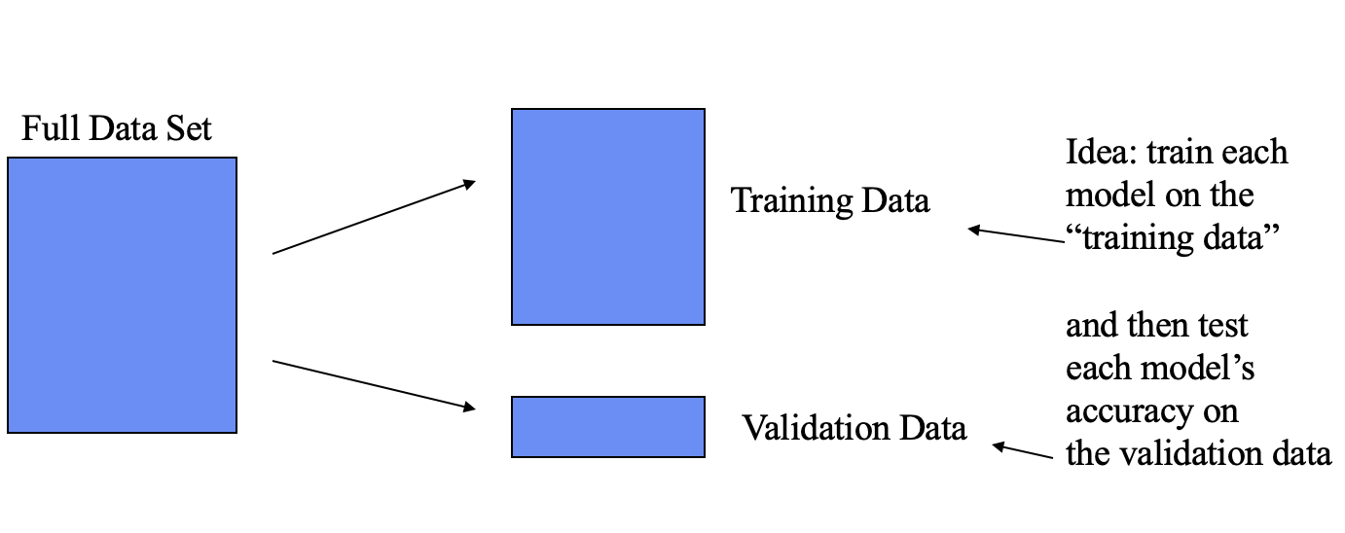
Validation
Methods for Performance Evaluation
Holdout method
Given data is randomly partitioned into two independent sets
Training set (e.g., 2/3) for model construction
Test set (e.g., 1/3) for accuracy estimation

Slide 25
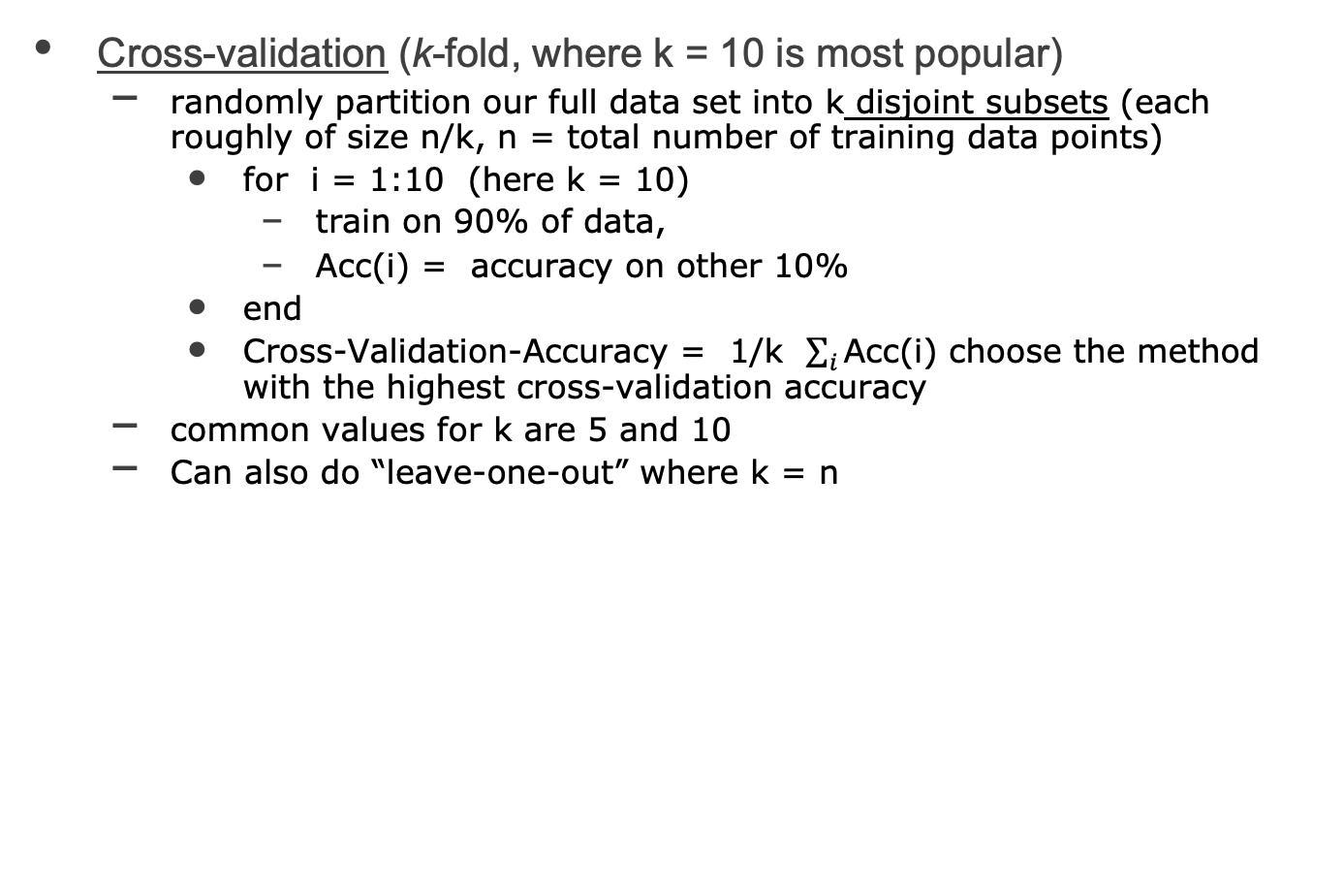
Validation
Methods for Performance Evaluation
Cross-validation (k-fold, where k = 10 is most popular)
randomly partition our full data set into k disjoint subsets (each roughly of size n/k, n = total number of training data points)
for i = 1:10 (here k = 10)
train on 90% of data,
Acc(i) = accuracy on other 10%
end
Cross-Validation-Accuracy = 1/k $\sum_{i}{\text{Acc}\text{(}\text{i}\text{) }}$choose the method with the highest cross-validation accuracy
common values for k are 5 and 10
Can also do “leave-one-out” where k = n

Slide 26
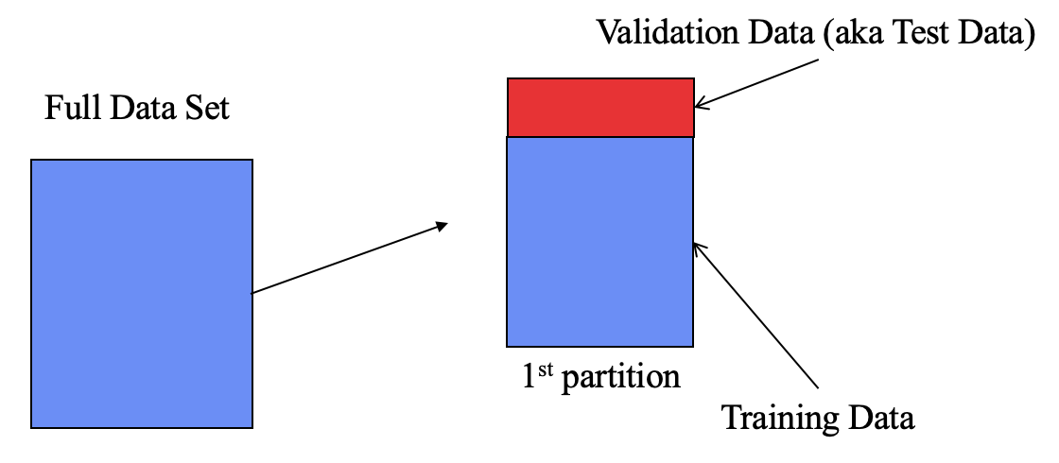
Validation
Methods for Performance Evaluation
Cross-validation (k-fold)
Disjoint Validation Data Sets

Slide 27
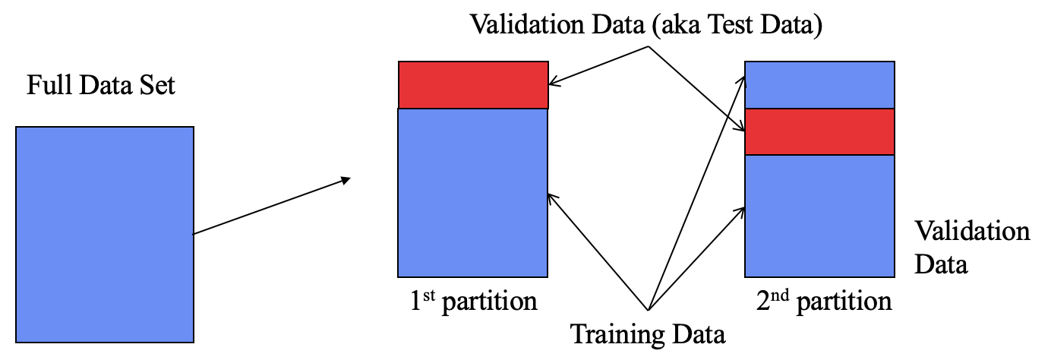
Validation
Methods for Performance Evaluation
Cross-validation (k-fold)
Disjoint Validation Data Sets

Slide 28
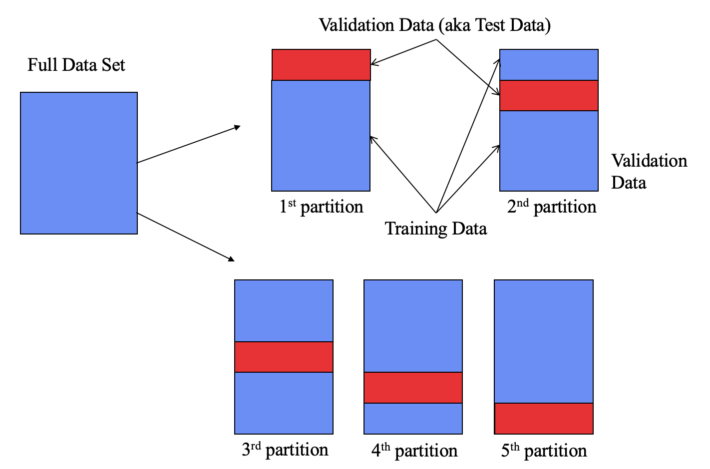
Validation
Methods for Performance Evaluation
Cross-validation (k-fold)
Disjoint Validation Data Sets

Slide 29
Validation
Methods for Performance Evaluation
Cross-validation (k-fold)
Notes
cross-validation generates an approximate estimate of how well the learned model will do on “unseen” data
by averaging over different partitions it is more robust than just a single train/validate partition of the data
“k-fold” cross-validation is a generalization
partition data into disjoint validation subsets of size n/k
train, validate, and average over the v partitions
e.g., k=10 is commonly used
k-fold cross-validation is approximately k times computationally more expensive than just fitting a model to all of the data

Slide 30
Validation
Model Evaluation
Metrics for Performance Evaluation
How to evaluate the performance of a model?
Methods for Performance Evaluation
How to obtain reliable estimates?
Methods for Model Comparison
How to compare the relative performance among competing models?

Slide 31
Validation
Methods for Model Comparison
ROC (Receiver Operating Characteristic)
Developed in 1950s for signal detection theory to analyze noisy signals
Characterize the trade-off between positive hits and false alarms
ROC curve plots TPR (on the y-axis) against FPR (on the x-axis)
Performance of each classifier represented as a point on the ROC curve
If the classifier returns a real-valued prediction,
changing the threshold of algorithm changes the location of the point

Slide 32
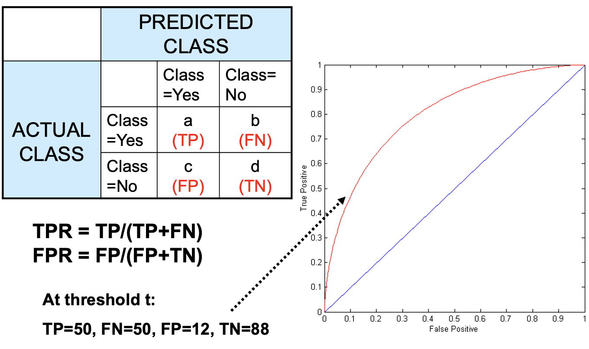
Validation
Methods for Model Comparison
ROC (Receiver Operating Characteristic)

Slide 33
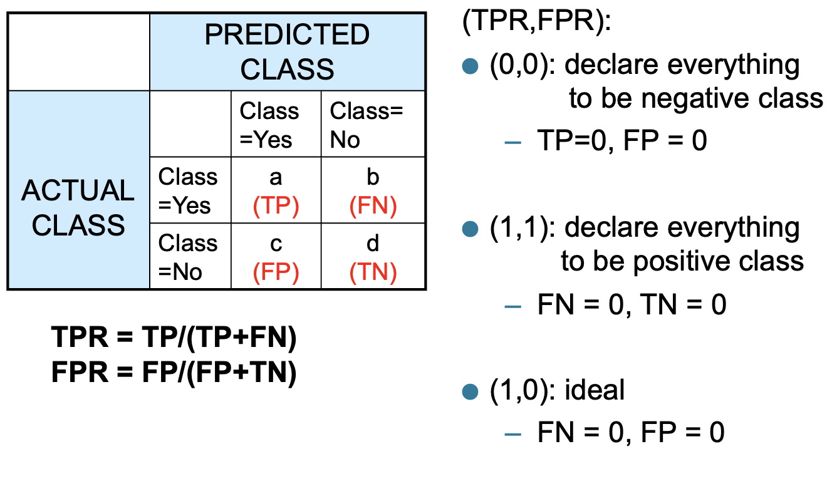
Validation
Methods for Model Comparison
ROC (Receiver Operating Characteristic)

Slide 34
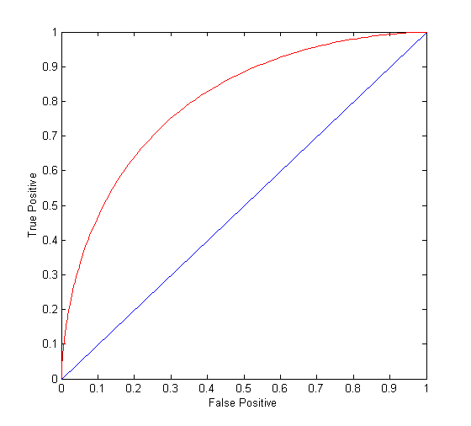
Validation
Methods for Model Comparison
ROC (Receiver Operating Characteristic)
(TPR,FPR):
(0,0): declare everything to be negative class
(1,1): declare everything to be positive class
(1,0): ideal
Diagonal line:
Random guessing
Below diagonal line:
prediction is opposite of the true class

Slide 35
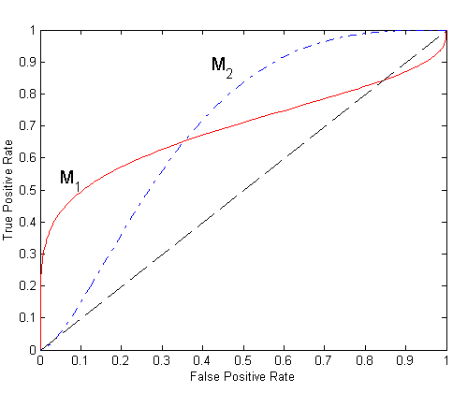
Validation
Methods for Model Comparison
Using ROC for Model Comparison
No model consistently outperforms the other
M₁ is better for small FPR
M₂ is better for large FPR
Area Under the ROC curve (AUC)
Ideal:
Area = 1
Random guess:
Area = 0.5

